Slide 1
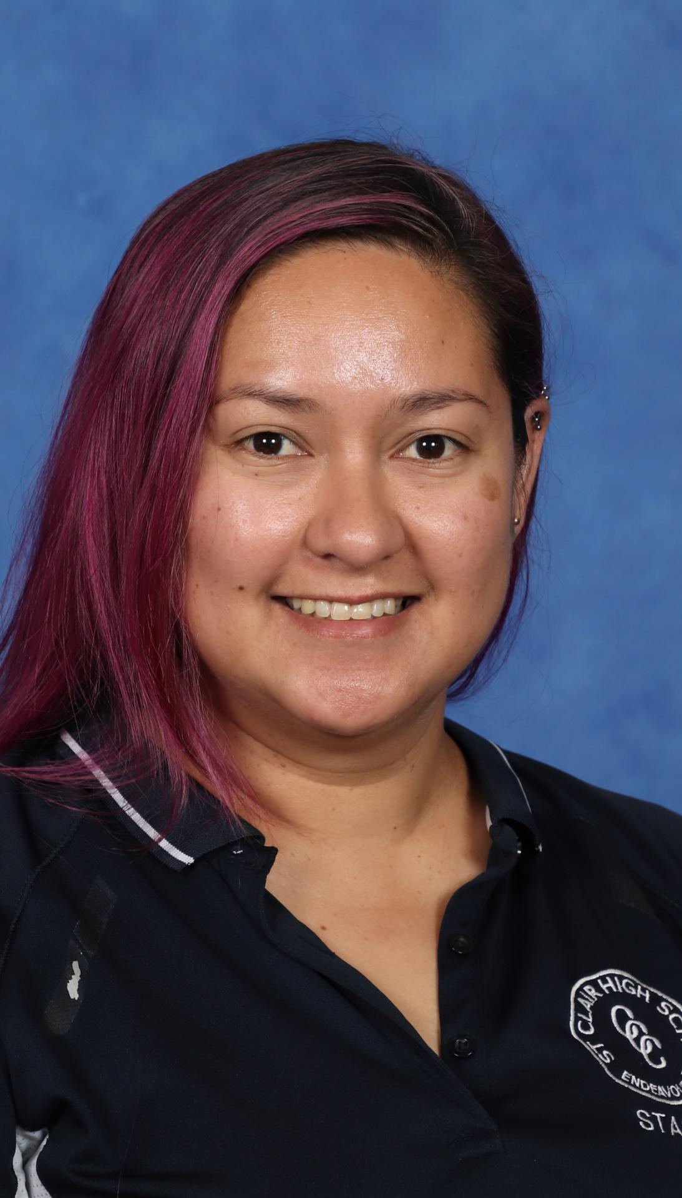
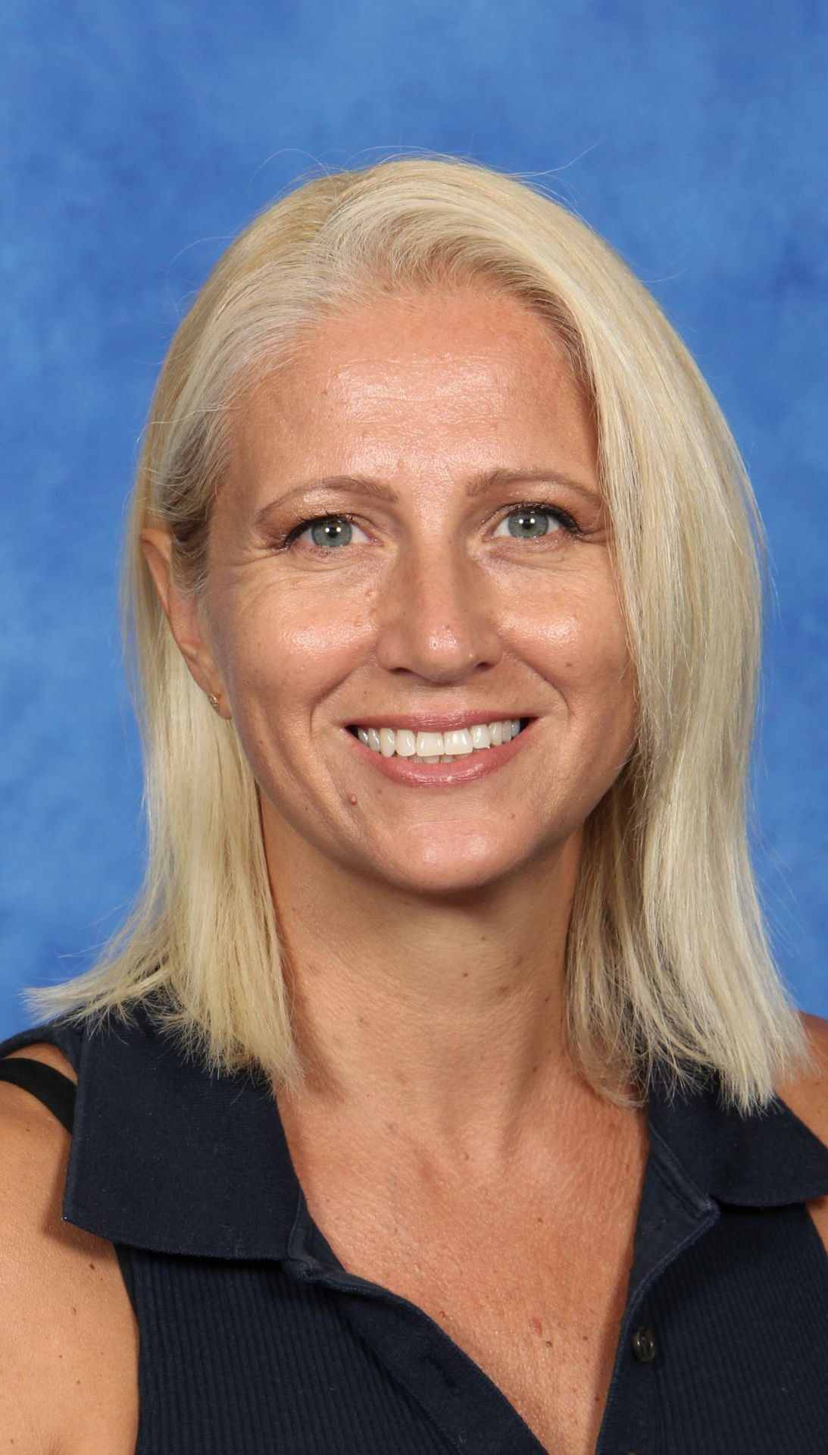
Community and Family Studies
With Mrs Susnjara and Mrs Lane

Slide 2
Students have been developing skills in…
Critical Thinking: Analysing and evaluating different resource management strategies and their impacts on families and communities.
Problem-Solving: Identifying challenges related to resource use and proposing effective solutions.
Planning and Organising: Creating resource management plans that consider various factors, such as time, budget, and community needs.
Collaboration: Working in groups to discuss and share ideas, enhancing teamwork and communication skills.
Research Skills: Gathering and synthesising information from various sources to inform their understanding of resource management issues.
Reflective Practice: Assessing their own resource management choices and considering improvements for the future.

Slide 3
Students will develop…
1. knowledge and understanding about resource management and its role in ensuring individual, group, family and community wellbeing
2. knowledge and understanding about the contribution positive relationships make to individual, group, family and community wellbeing
3. knowledge and understanding about the influence of a range of societal factors on individuals and the nature of groups, families and communities
4. knowledge and understanding about research methodology and skills in researching, analysing and communicating
5. skills in the application of management processes to meet the needs of individuals, groups, families and communities
6. skills in critical thinking and the ability to take responsible action to promote wellbeing
7. an appreciation of the diversity and interdependence of individuals, groups, families and communities.

Slide 4
The Modules
Community and Family Studies Stage 6 aims to develop in each student an ability to manage resources and take action to support the needs of individuals, groups, families and communities in Australian society.
1
Resource Management: Students have been learning about the fundamental importance of the skill of resource management, which is the use of resources to satisfy needs in order to achieve wellbeing.
2
Families and Communities: This module provides students with an insight into family structures and communities and the roles individuals adopt within each. The module requires students to examine how constant change challenges families and communities, and that both informal and formal support available can assist them to manage the change effectively.
3
Individuals and Groups: This module explores the role that individuals and groups play in meeting the specific needs of individuals, families and communities. Students explore the importance of building positive interpersonal relationships in order to promote a sense of belonging among individuals, families and social groups.
4

Slide 5
Prepared for learning
Students must bring laptops to access Google Classroom and conduct research
Students must being writing equipment

Slide 6
Assessment Schedule
All assessments are posted on Google Classroom and a physical copy is given to each student at least 2 weeks prior to the due date.
Task 1 – Resource Management
Resource management and interview; design, conduct and analyse an interview
Due in Term 1, Week 9
Task 2 – Families and Communities
Research and questionnaire construction
Due in Term 2, Week 8
Task 3 – Yearly Examination
Due in Term 3, Weeks 2-3

Slide 7
Upcoming assessment task
Task 2 – Families and Communities
Research and questionnaire construction
Due in Term 2, Week 8
Part 1 – Research a Current Family Structure and present findings on a PowerPoint presentation
Part 2 – Questionnaire construction and proposal
Construct a Formal Questionnaire that could be used to identify demographics of the St Clair Community
Propose how you would administer the questionnaire if it were to be done

Slide 8
Homework
Students do not regularly receive homework tasks.
Homework may include completing unfinished class activities, or completing revision tasks on Edrolo.
The expectation is that students complete all set class tasks to fully develop their knowledge and understanding of key concepts.

Slide 9
If you have further questions,
Please do not hesitate to reach out to us on our digital learning platforms (Google Classroom)
Or through email
Christine.Susnjara@det.nsw.edu.au
Kimberly.Lane3@det.nsw.edu.au

Slide 10
Year 11 Community and Family Studies Resources
NESA – Stage 6 Community and Family Studies Syllabus
https://educationstandards.nsw.edu.au/wps/portal/nesa/11-12/stage-6-learning-areas/pdhpe/community-family-studies-syllabus
Edrolo
https://edrolo.com.au

