Slide 1
Year 11 Design & Technology
With Mrs Susnjara

Slide 2
Students have been developing:
confidence, competence and responsibility in designing, producing and evaluating by meeting both needs and opportunities, and developing understanding of the factors that contribute to successful design and production.

Slide 3
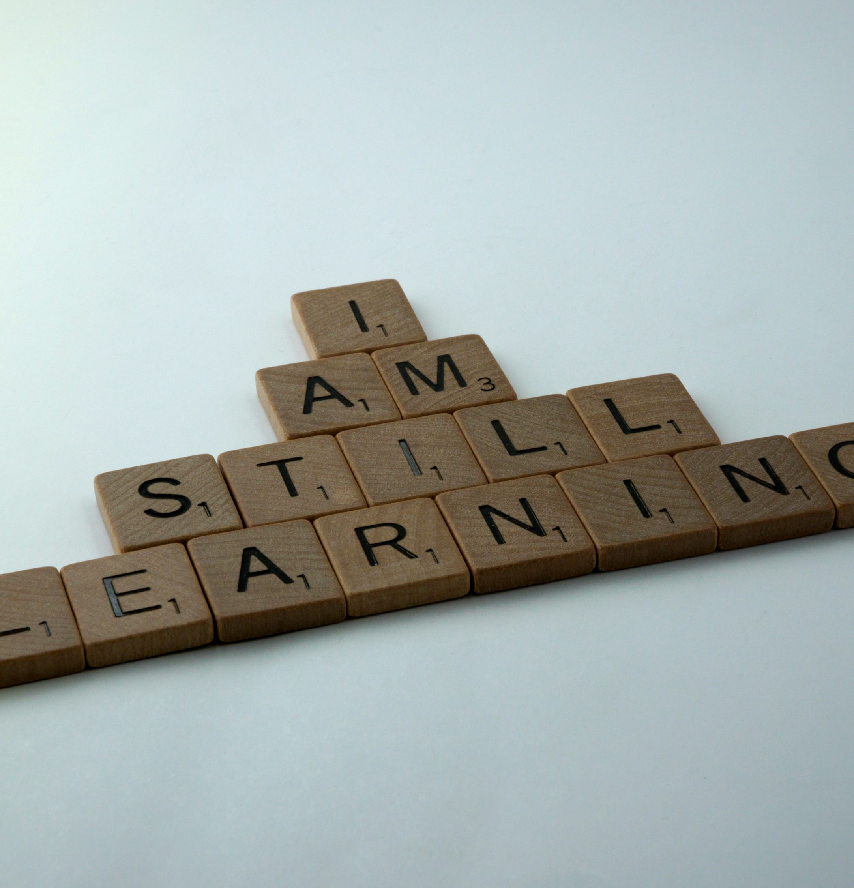
Students will develop:
knowledge and understanding about design theory and design processes in a range of contexts;
knowledge, understanding and appreciation of the interrelationship of design, technology, society and the environment;
creativity and an understanding of innovation and entrepreneurial activity in a range of contexts;
skills in the application of design processes to design, produce and evaluate quality design projects that satisfy identified needs and opportunities;
skills in research, communication and management in design and production;
knowledge and understanding about current and emerging technologies in a variety of settings.

Slide 4
Prepared for Learning:
Students must wear leather shoes
01
Students must bring writing equipment
02
Students must bring laptops to access Google Classroom and conduct research
03

Slide 5
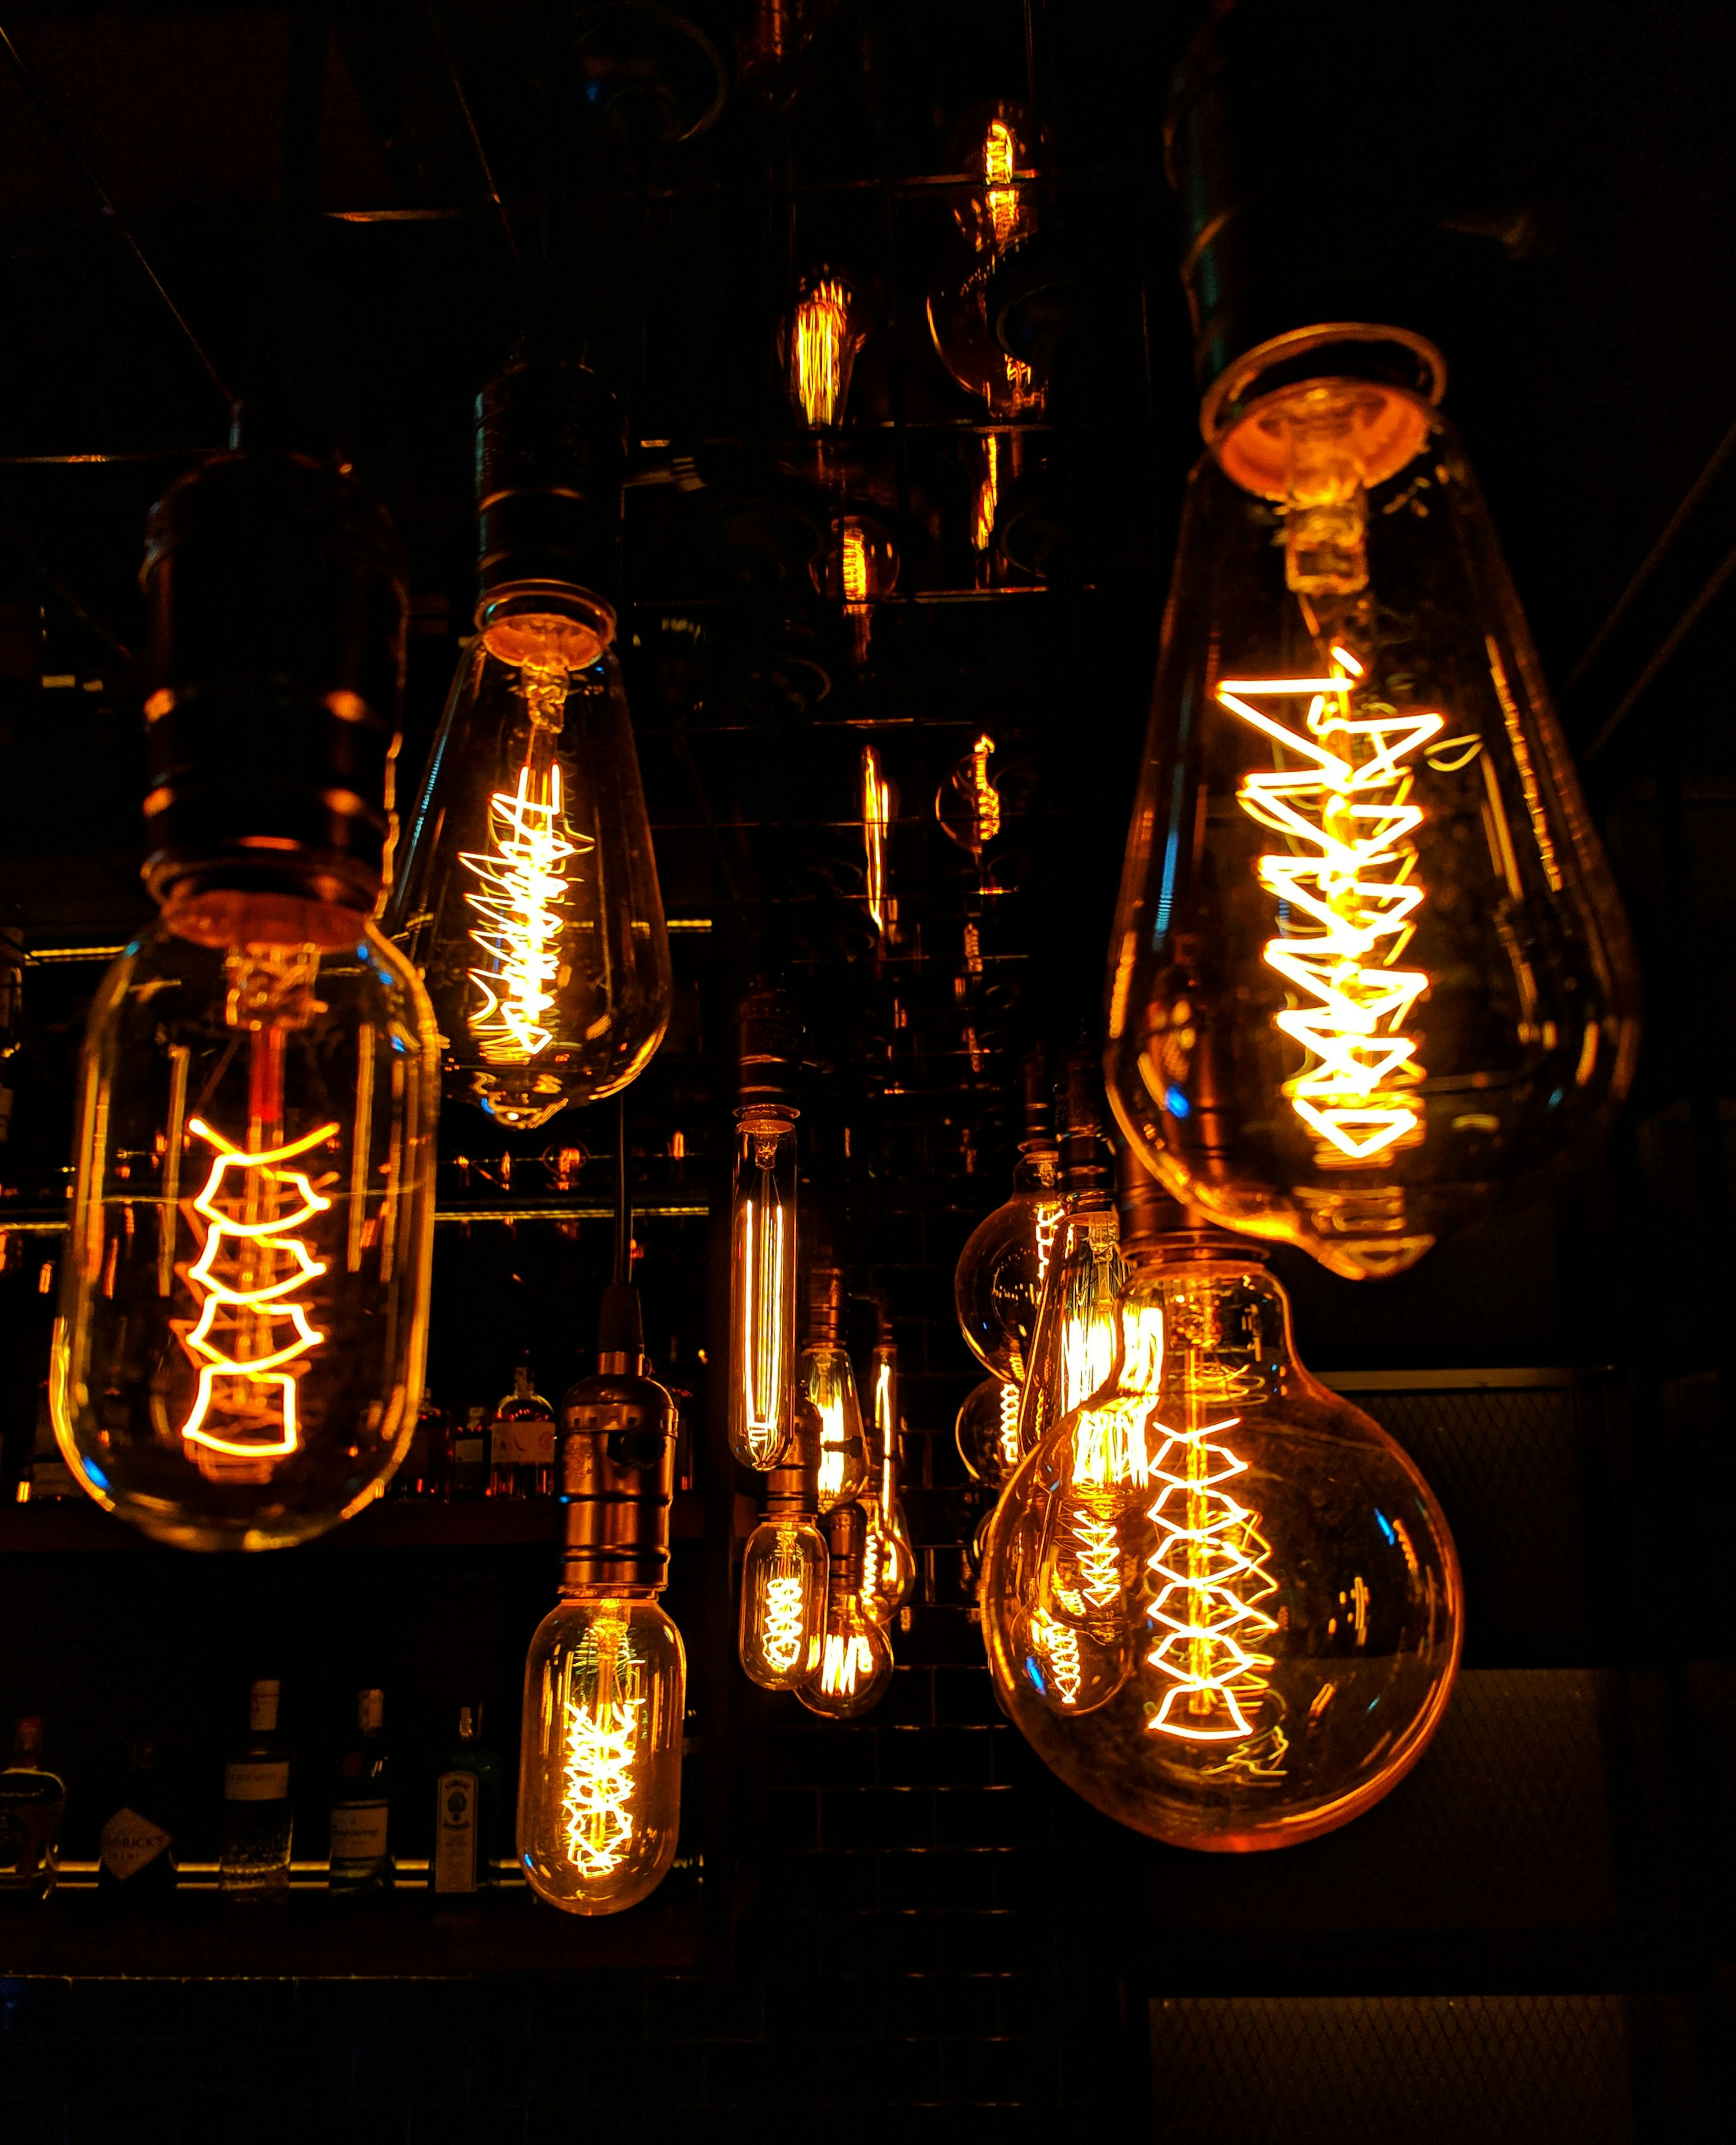
Upcoming assessment
Assessment Task 2: Project 1 & Folio
This is a teacher led assessment task where students work together in a design team of 2-3 students.
The design team will develop a LED lighting product that promotes the 3 'R's (reduce, reuse, recycle) and will be utilised in an environment/room of your choice.
Students are required to document their work with a Folio. The teacher will provide students with a folio guide to work through the design process

Slide 6
Assessment Schedule
All assessments are posted on Google Classroom and a physical copy is given to each student at least 2 weeks prior to due date.
Task 1 – Research Assessment (Australian & International designer)
Due in Term 1, Week 7
Task 2 – Project 1 & Folio (Lighting Design Project)
Due in Term 2, Week 8
Task 3 – Yearly Examination
Term 3, Weeks 2 - 3

Slide 7
Homework
Students do not regularly receive homework tasks.
01
Homework may include completing unfinished class activities, completing assessments or preparation for an examination.
02
The expectation is that students complete all set class tasks to fully develop their knowledge and understanding of key concepts.
03

Slide 8
Year 11 Design & Technology Resources
NESA - Stage 6 Design & Technology Syllabus
https://educationstandards.nsw.edu.au/wps/portal/nesa/11-12/stage-6-learning-areas/tas/design-and-technology-syllabus

