Slide 1









Year 11 2025
HEALTH AND MOVEMENT SCIENCE

Slide 2
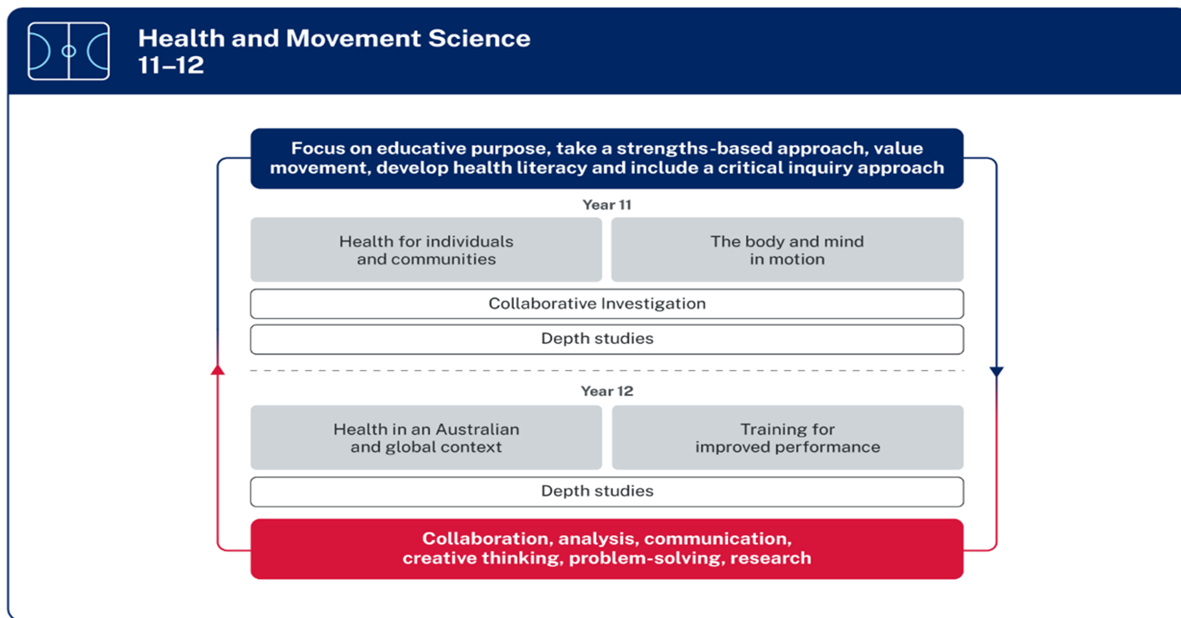
WHAT STUDENTS WILL LEARN ABOUT

Slide 3
STUDENTS HAVE BEEN LEARNING ABOUT
Module 1- : Health for individuals and communities
● This module has a focus on the health of young people
● Students explore the meanings of health
● Students explore how government and non-government organisations can advocate and support the health of young people
● Students investigate the determinants of health and how they connect with each other

Slide 4


STUDENTS HAVE BEEN DEVELOPING SKILLS IN
Collaboration
Analysis
Communication
Problem-solving
Research
Creative thinking

Slide 5
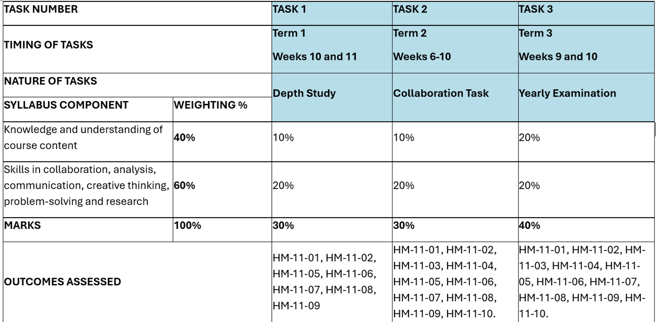
ASSESSMENTS

Slide 6

THE UPCOMING ASSESSMENT REQUIRES STUDENTS TO
Depth Study - Due April 11th
Students are required to investigate ONE health-related issue for young people in NSW.
Part A- Requires students to complete a booklet of questions relating to the health issue they choose.
Part B- Students will need to create a presentation as a group based on the research and responses in the booklet.
Part C- Students need to complete a written report of 500 words individually. The written report is a summary of research.

Slide 7

HOMEWORK
● Research activities
● Any work not completed in class time
● Writing tasks where students focus on practice HSC questions using ALARM and TEEL. (Topic Sentence, Explain, Example and Link)

Slide 8
If you have any further questions, please don’t hesitate to contact me at school either:
Phone: 9670 6700
OR
Email: stclair-h.school@det.nsw.edu.au

