Slide 1
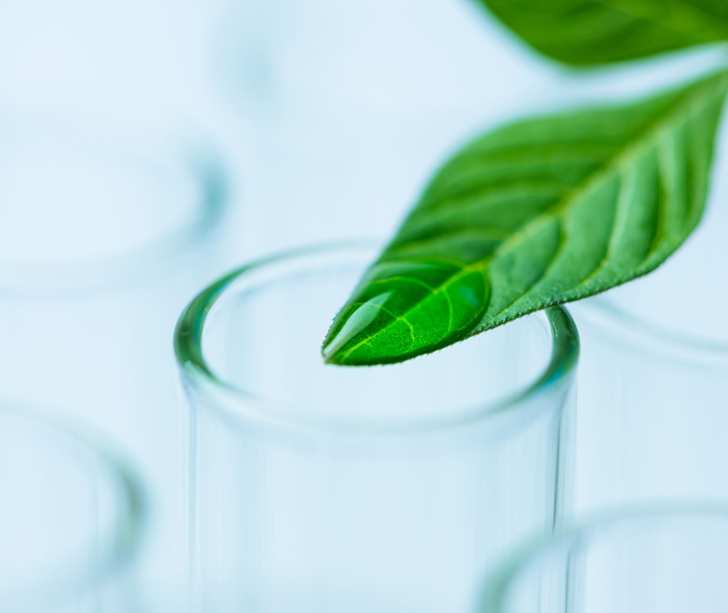
Year 11 Investigating Science
2025

Slide 2
Mrs Rebecca Ralph
A bit about myself
I am the Head Teacher of Science and have proudly taught at St Clair High School for 20 years. This year marks the 6th time I’ve taught the Investigating Science course.
Why I Love Teaching Science
I’m passionate about science because it encourages curiosity, critical thinking, and discovery. I love helping students explore how Science explains the world around them and seeing them develop skills that empower their future.

Slide 3
What Students Are Learning in Topic 1
Observation & Investigation: Students learn that all scientific investigation starts with careful observation. They are taught to ask meaningful questions about the world around them and investigate real-world phenomena.
Collecting Data: They gather both qualitative (descriptive) and quantitative (numerical) data, using a variety of tools and methods.
Practical Investigations: Students design and conduct their own experiments, either individually or in groups, focusing on making reliable observations and testing scientific hypotheses.
Key Skills Developed:
✔️ How to develop and evaluate scientific questions and hypotheses ✔️ How to collect valid, reliable primary and secondary data ✔️ How to analyse information using a range of media ✔️ How to understand the role of observation in driving scientific progress

Slide 4
Assessment Tasks
Assessment task 1 was handed out Week 7. This is a depth study, students have been allocated 10 hours of class time to assist in the completion. They are required to complete scientific research on solar power or wind power, complete an experiment and write a scientific paper. This is due Week 10 4/4/25 at 8:20am in the morning uploaded electronically to Teams. A paper copy is to be handed in at the start of their lesson that day P2.
Assessment task 2 will be completed in Week 3 Term 2. This will be an in-class task based on the excursion that is being run on Wednesday Week 1 Term 2 to Penrith Lakes.30/4/25. Students are expected to attend the excursion this has been sent out via SchoolBytes.
Assessment Task 3 will be the Final examination at end of Term 3.

Slide 5
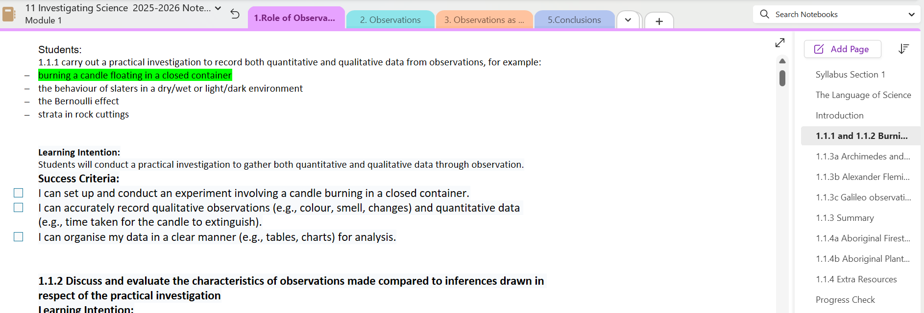
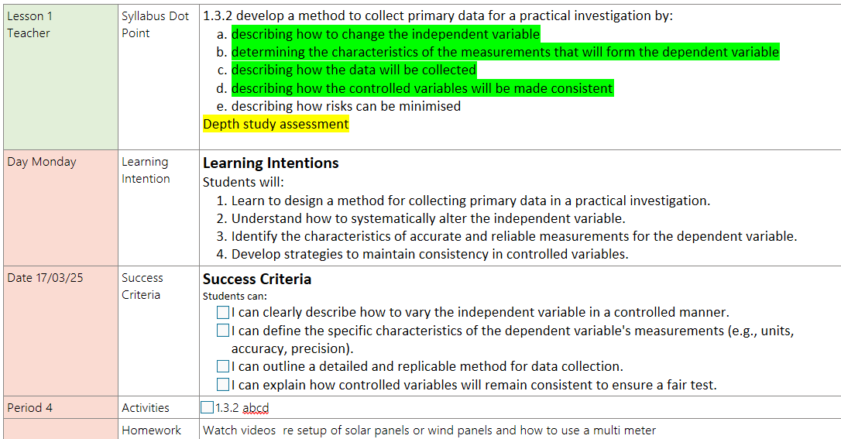
Course Requirements
Student will need to have a charged laptop every lesson.
Course Content can be found on Onenote under relevant syllabus dotpoint tab.
If students are absent- work for the lesson can be found in Collaboration Space for the relevant Term/Week /Day.
Assignments and Notifications will be published and submitted on Teams.

Slide 6
Homework
Students receive homework every day they have class, 4x per week this usually takes the form of
Watching a video on Atomi or Edrolo
Completing questions that consolidates the learning from the lesson in their class Onenote.

Slide 7
Further questions or want to have a chat.
If you have any further questions, please do not hesitate to reach out to me on Sentral parent portal or my email.
Rebecca.e.ralph@det.nsw.edu.au

