Slide 1

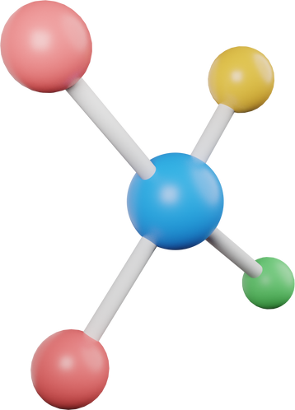



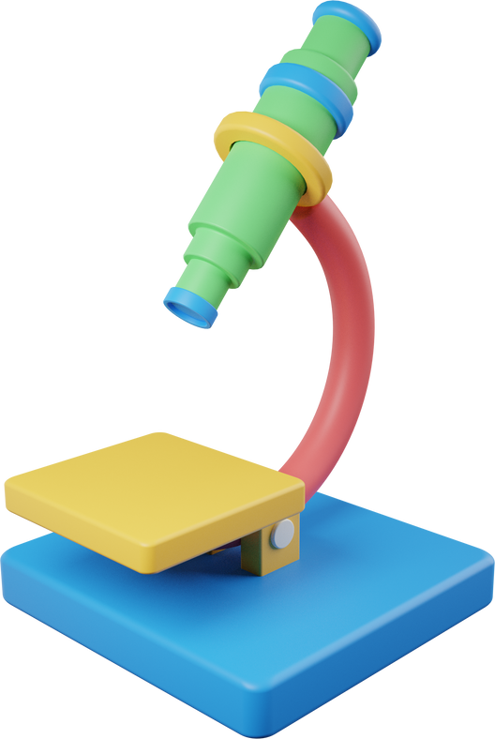




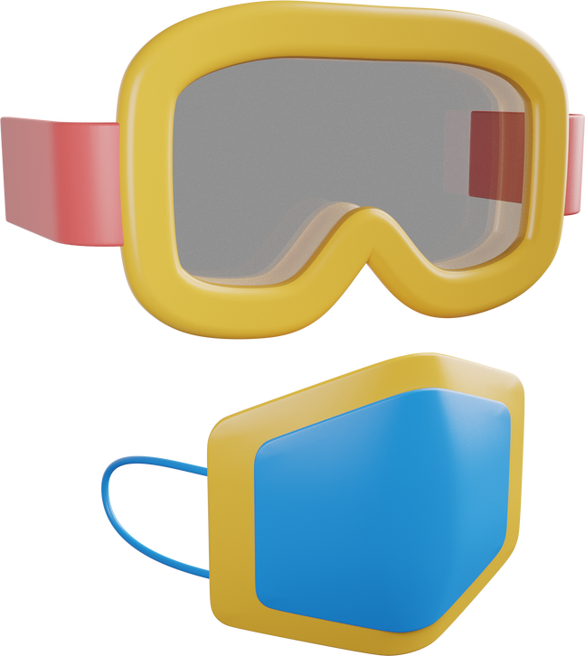


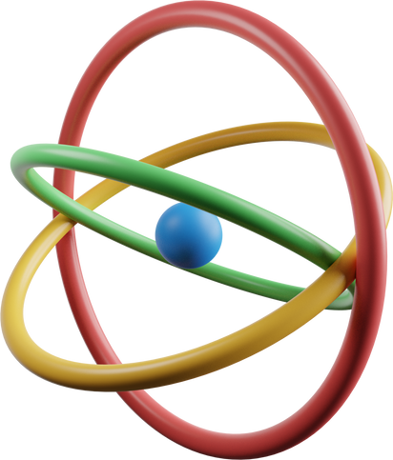
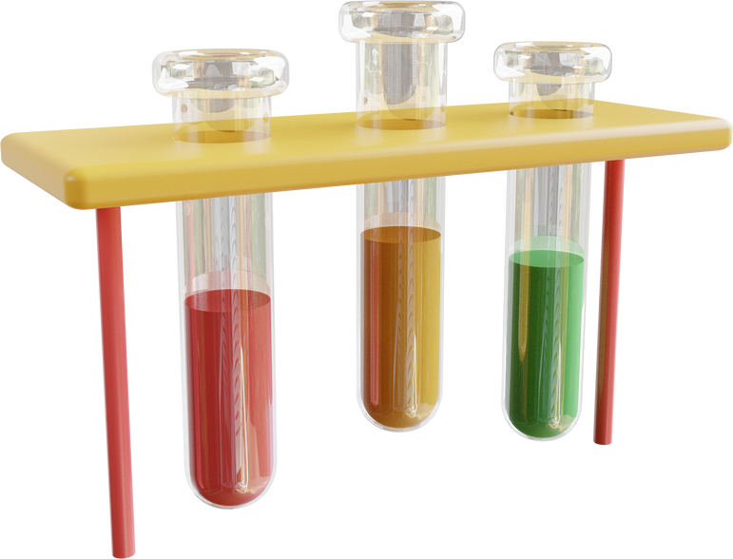
11 PHYSICS
2025
MR NITISH PRAKASH

Slide 2


About me
HELLO! MY NAME IS NITISH PRAKASH, AND I AM A PHYSICS TEACHER AT ST CLAIR HIGH SCHOOL. I HAVE BEEN TEACHING HERE SINCE 2020. THOUGH I’VE RECENTLY STARTED TEACHING PHYSICS, I’VE FOUND IMMENSE ENJOYMENT IN THE SUBJECT—ESPECIALLY THE CHALLENGE OF COMPLEX MATHEMATICS AND CONCEPTS. I LOVE BEING ABLE TO TEST AND VISUALLY EXPERIENCE MATHEMATICAL SCENARIOS IN THE REAL WORLD, MAKING PHYSICS BOTH FUN AND FASCINATING.
BEYOND THE CLASSROOM, I’M AN OUTGOING AND ENTHUSIASTIC PERSON WHO ENJOYS FISHING, PLAYING CARD GAMES, AND SPENDING TIME WITH THE PEOPLE I LOVE. DEEP AND MEANINGFUL CONVERSATIONS HAVE ALWAYS DRAWN ME IN, AND I THINK THAT CURIOSITY HAS FUELED BOTH MY PASSION FOR SCIENCE AND MY LOVE OF TEACHING. I STRIVE TO MAKE LEARNING AN ENGAGING AND THOUGHT-PROVOKING EXPERIENCE, HELPING STUDENTS SEE THE BEAUTY OF PHYSICS IN EVERYDAY LIFE.

Slide 3



STUDENTS HAVE BEEN LEARNING ABOUT
MOTION IN A STRAIGHT LINE
MOTION ON A PLANE
In this topic, students learn how objects move in a straight line using key ideas like displacement, velocity, acceleration, and time. They analyze motion with graphs, formulas, and real-world examples, including free-fall motion. By solving problems and doing experiments, they build a strong foundation for understanding forces, energy, and everyday movement.
KINEMATICS
In this topic, students explore motion in two dimensions, including projectile motion and vector analysis. They learn how to break motion into horizontal and vertical components and use graphs and equations to predict movement. Through problem-solving and experiments, students develop a deeper understanding of real-world motion, such as how objects move through the air.

Slide 4



SKILLS DEVELOPED IN MOTION IN A STRAIGHT LINE AND MOTION ON A PLANE
  Mathematical Problem-Solving – Using equations to analyze motion, calculate velocity, acceleration, and displacement.
  Graphical Interpretation – Reading and drawing motion graphs to understand changes in speed and direction.
  Vector Analysis – Breaking motion into components (especially in motion on a plane) to solve problems more effectively.
  Experimental Skills – Conducting investigations to measure motion and test predictions.
  Critical Thinking – Applying concepts to real-world scenarios like free fall, projectile motion, and everyday movement.
  Communication – Explaining motion using scientific language, diagrams, and mathematical reasoning.

Slide 5
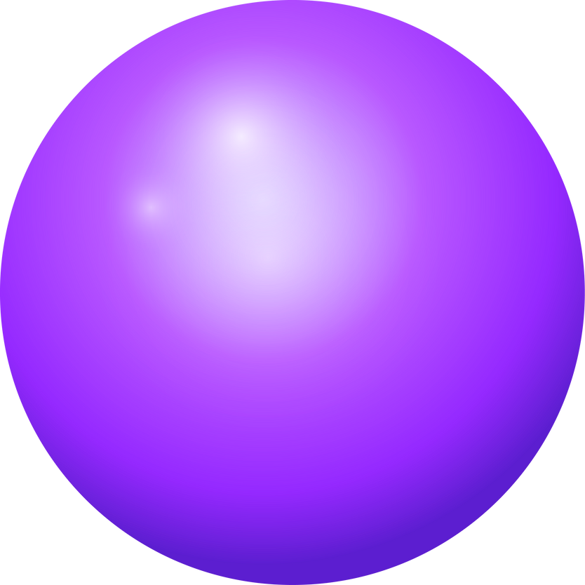





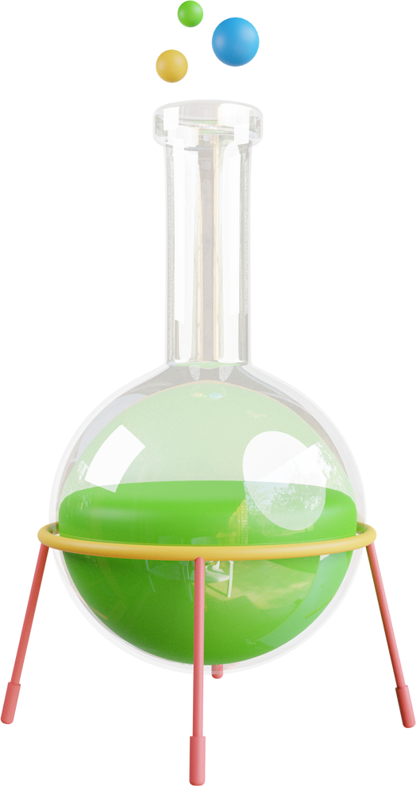
Kinematics Physics Practical Examination
ASSESSMENT
ASSESSMENT IS IN CLASS
ON THE WEDNESDAY 9TH OF APRIL 2025

Slide 6
Kinematics Physics Practical Examination
ASSESSMENT
THIS UPCOMING ASSESSMENT REQUIRES STUDENTS TO BRING:
-CALCULATOR
-PENCIL
-PEN
-RULER
-ERASER

Slide 7

HOMEWORK
Students recieve homework everyday
  This is normally recieve it everyday in the form of sample questinos in their booklet.
  Students also have access to Edrolo and Atomi to help with understanding concepts when they are not at school.
  Students Booklet work is kept up to date and is checked every lesson.
  Support is provided in and outside of class time at lunch or recess if students have any questions.

Slide 8


THANK YOU!
IF YOU HAVE ANY FURTHER QUESTIONS, PLEASE DO NOT HESITATE TO REACH OUT TO ME ON
-SENTRAL PARENT PORTAL
-MY EMAIL NITISH.PRAKASH3@DET.NSW.EDU.AU

