Slide 1












Sport, Lifestyle and Recreation
(SLR) YEAR 11

Slide 2








Students have been learning about
Module 1- Sports Coaching
  Students develop knowledge, understanding and skills in sports coaching and training methodology
  Students examine the roles and responsibilities of the coach
  Students will instruct their own coaching program within this module

Slide 3
Students have been developing skills in
  Collecting, Analysing and Organising Information
  Communicating Ideas and Information
  Planning and Organising Activities
  Working With Others and in Teams
  Using Mathematical Ideas and Techniques
  Using Technology
  Solving Problems

Slide 4



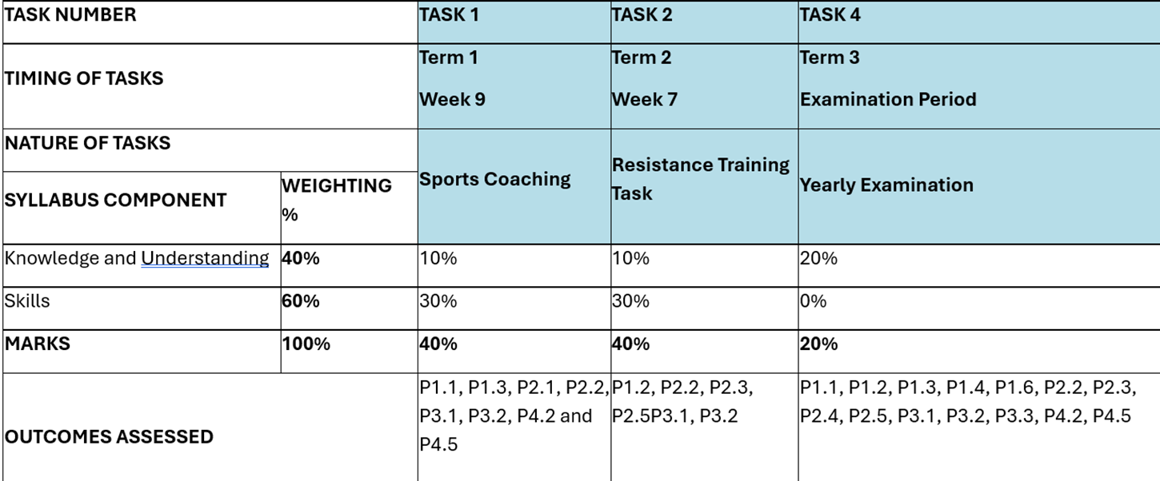
assessments

Slide 5



The upcoming assessment requires students to
Students will respond to 4 short answer questions and 1 extended response. The questions will focus on:
  Characteristics of an effective coach
  Instructional style
This assessment focused on writing skills using ALARM and TEEL- getting students ready for their HSC.

Slide 6




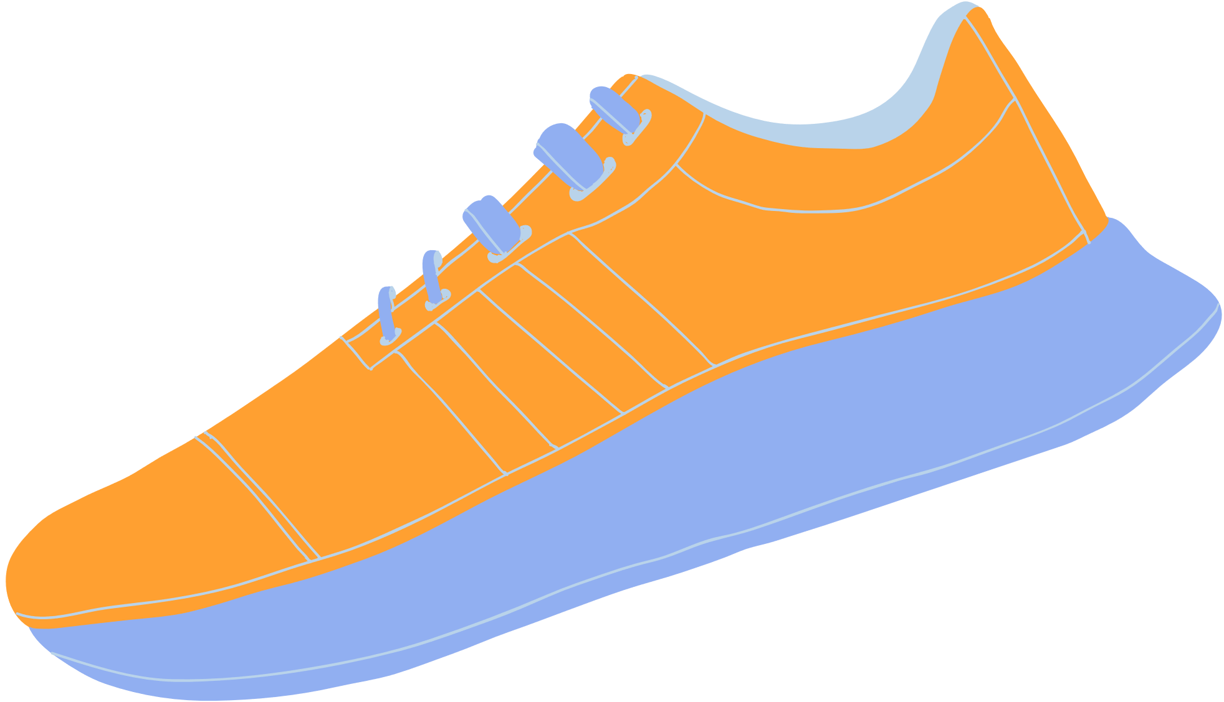
HOMEWORK
  Homework may include:
  Research activities
  Any work not completed in class time
  Writing tasks where students focus on practice HSC questions using TEEL. (Topic Sentence, Explain, Example and Link)

Slide 7
If you have any further questions, please don’t hesitate to contact me at school either:
Phone: 9670 6700
OR
Email: stclair-h.school@det.nsw.edu.au

