Slide 1
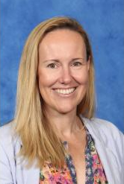
2025
Year 11 Subject Update Information Packages
Ms Nicole Holt, Deputy Principal

Slide 2
Purpose of the information packages:
Update on how Year 11 have started their Stage 6 schooling
Guide on the Assessment booklet / policy
Your children are all studying at least 6 subjects. Each subject area will provide a quick synopsis detailing:
- The teacher of the subject area
- The topics being studies and the skills being developed
- Current assessment – due dates and requirements
- Avenues of contact should you require further information

Slide 3
Year 11 – the HSC cohort of 2026 – have started their Stage 6 studies well!
Lots of positive feedback about this excellent year group!

Slide 4
Preliminary Assessment Booklet
Every Year 11 student has been issued a 2025 Preliminary Assessment Booklet
Spares are available from Ms Holt if required
Available on the school website under ‘Assessment and Reporting’

Slide 5
Preliminary Assessment Booklet: Key Items
Achieving the HSC Credential
Illness / Misadventure
Malpractice
NESA Requirements
Eligibility
Unsatisfactory Progress
Disability Provisions
Completion of Coursework and Assessment
Plagiarism
Misrepresentation
Collusion
Breach of examination conditions
The use of Artificial Intelligence (AI)
The N Warning Process
Procedures relating to illness and misadventure (these are formalised NESA processes)
Submitting an appeal

Slide 6
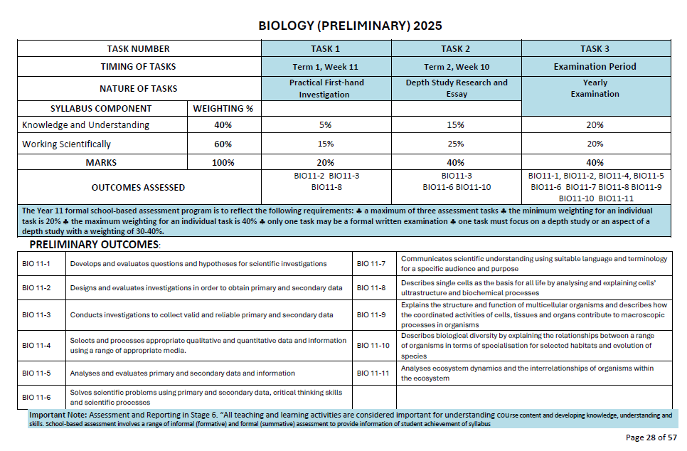
The Preliminary Assessment Booklet includes the Assessment Schedules for each Year 11 subject offered in 2025.
An example is included here

Slide 7
Assessment
Students should have received their first assessment task for their courses.
It is expected that all students will complete and submit assessment as they fall due.
It is imperative that students work hard to complete the very best work they are capable of in all assessment and coursework.

Slide 8
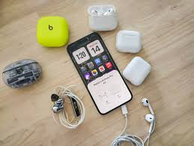
Reminders:
Mobile Phone Policy
School Late Policy
Mobile phones and headphones/ earphones / earbuds are not permitted at school – first bell to last bell.
See policy on school comms.
Students are expected to be on site at 8:25am.
Lateness without a parent / carer note and valid reason is not acceptable.

Slide 9
Mark in your diaries:
Parent Teacher Night 7-12
Week 2, Term2
May 7th (3pm-7pm)
If you have any questions:
Please contact the school on 02 9670 6700 or email: stclair-h.school@det.nsw.edu.au

